Slide 1
Quantum AI Mini Seminar Series: Exploring the Future of Computing and Artificial Intelligence
Luke Miller

Slide 2
Summary
Session 1: Quantum Fundamentals - 10/3/2024
Session 2: Quantum Algorithms - 10/17/2024
Session 3: Quantum ML (QML) - 10/31/2024
Session 4: Quantum GNNs (QGNNs) - 11/14/2024
Further Sessions: TBD
Time: 10:00 AM
Place: FH337
https://umsystem.zoom.us/j/2174320035?pwd=b1lRVTZ1enpYYWQ3dzVacFBiRC9CUT09 passcode:UMKC

Slide 3
Quantum AI Mini Seminar Series:
Session 1: Quantum Computing Fundamentals
Introduction to Quantum Computing
Classical Bits vs. Qubits
Superposition & Entanglement
Basic Quantum Gates
Quantum Computing for AI

Slide 4
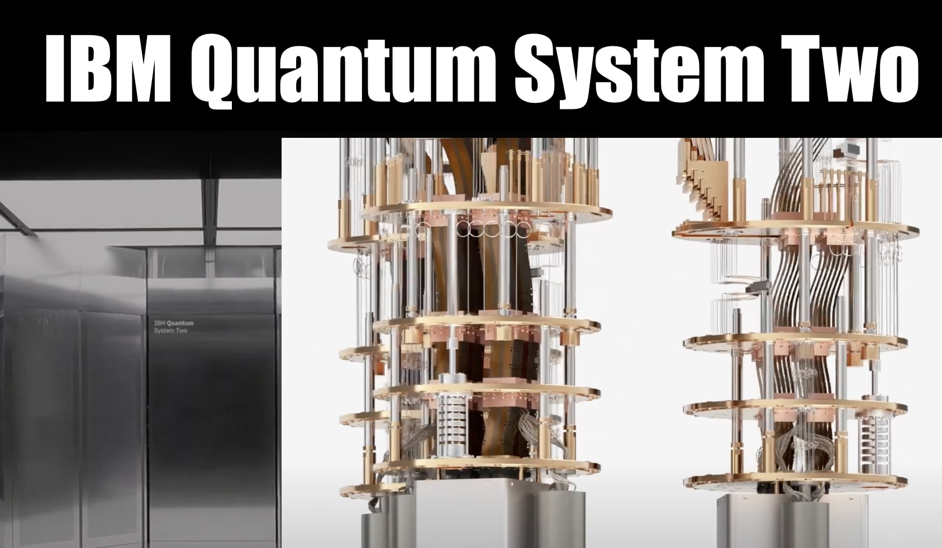
Quantum Computing Fundamentals
Quantum Computing Power
How do Quantum Computers work?
Relevance to AI
Ignoring the Elephant in the Room: Quantum Strangeness
Notes:
Quantum Computing Power
Quantum Mechanics & Parallelism:
Quantum mechanics allows us to harness parallelism in ways classical computers cannot.
Superposition enables qubits to represent and process multiple states at once, leading to an exponential increase in computing power compared to classical bits.
Entanglement allows qubits to become interconnected, enabling operations across qubits instantaneously.
How Do Quantum Computers Work?
Quantum Hardware:
Current technologies include ion traps, superconducting qubits, and photonic qubits. Each of these uses different physical phenomena to maintain and control qubits.
Companies like Atom Computing and IBM have developed quantum computers with over 1,000 qubits. Both Google and IBM aim for 1 million qubits within the next decade.
However, we are currently in the Noisy Intermediate Scale Quantum (NISQ) era. Our quantum computers are noisy and limited in the number of qubits, making it challenging to achieve fault tolerance and quantum advantage just yet.
Relevance to AI
Quantum Parallelism & AI:
The parallelism of quantum computers could revolutionize AI by processing vast amounts of data simultaneously, especially for tasks like optimization and model training.
Superposition and entanglement allow for exploring multiple data paths or states at once, drastically speeding up tasks that are computationally expensive on classical systems.
Ignoring the Elephant in the Room: Quantum Strangeness
Quantum Strangeness:
Entanglement, superposition, and quantum teleportation defy our classical understanding of the world.
We still don’t fully understand why or how quantum phenomena violate locality (the principle that objects are only influenced by their immediate surroundings). This remains a hot topic in physics.
Despite this, we know quantum mechanics works because its effects are well-defined and reproducible in controlled environments. It’s like the use of electricity in the late 19th century: We didn’t fully understand it, but we could still utilize it.
Analogy: Just as early engineers used electricity despite not fully understanding the atom, we are now leveraging quantum mechanics while still unraveling its mysteries.

Slide 5
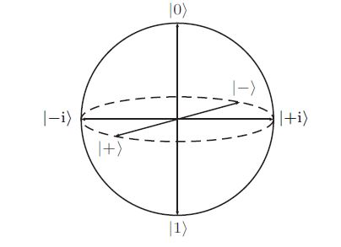
Classical Bits vs. Qubits
Classical Bits
Binary and Deterministic
Qubits
Superposition
Exist in a state of both 1 and 0 at the same time
Enables Parallelism
|ψ⟩ = α|0⟩ + β|1⟩
Entanglement
State of one qubit affects another
Quantum Communication
Bloch Sphere
Notes:
Classical Bits vs Qubits
Introduction:
Classical bits are the basic units of information in classical computing, while qubits are the fundamental units in quantum computing.
The difference between the two is what gives quantum computing its unique potential.
Classical Bits: Binary and Deterministic
Definition: Classical bits exist in one of two distinct states: 0 or 1.
This is similar to a light switch: it’s either on (1) or off (0).
Deterministic: A bit can only be in one of these two states at any given time.
Binary Logic: All classical computations are based on this two-state system, where each bit holds exactly one piece of information.
Example: Classical computers perform operations by manipulating these bits using logic gates like AND, OR, and NOT gates.
Qubits: Superposition & Parallelism
Superposition:
Unlike classical bits, qubits can exist in a superposition of both 0 and 1 at the same time.
Mathematically, this is expressed as |ψ⟩ = α|0⟩ + β|1⟩, where α and β are complex numbers representing probability amplitudes.
The qubit remains in this mixed state until it is measured, at which point it "collapses" into either 0 or 1.
Parallelism:
This ability to be in multiple states at once allows quantum computers to process information in parallel. It’s like having multiple computations running simultaneously with just one qubit.
Example: A classical bit can store either 0 or 1, but a qubit in superposition can represent both 0 and 1 simultaneously. This exponentially increases the computing power when many qubits are used together.
Entanglement: Connecting Qubits Beyond Locality
Entanglement:
When qubits become entangled, the state of one qubit is dependent on the state of another, no matter how far apart they are. This connection defies classical expectations.
Example: If you entangle two qubits and measure one, you instantaneously know the state of the other, regardless of distance.
Significance for Computing:
Entanglement allows quantum computers to perform computations on entangled qubits, enabling operations across qubits instantaneously. This feature is critical for quantum communication and computation.
Bloch Sphere: Visualizing a Qubit
Explanation:
The state of a qubit can be visualized on the Bloch sphere, a 3D representation.
The north pole represents |0⟩ and the south pole represents |1⟩, but a qubit can exist anywhere on the sphere due to superposition.
The sphere helps visualize how quantum gates manipulate qubits to perform computations by rotating them around different axes.

Slide 6
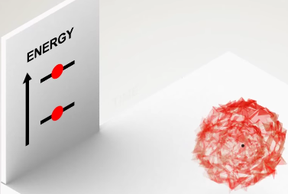
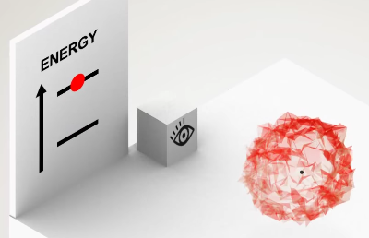
Superposition and Entanglement
Superpostion
Collapse: |α|² for |0⟩ and |β|² for |1⟩.
n qubits→2^{n} simulataneous configurations
Entanglement
Bell States and collapse
Non-locality
Communications efficiency
Superposition in AI
Entanglement in AI
Notes:
Superposition: A Core Concept in Quantum Computing
Introduction:
Definition: Superposition is the ability of a qubit to exist in a combination of the |0⟩ and |1⟩ states simultaneously, rather than being limited to just one or the other, as in classical bits.
Mathematical Representation:
A qubit’s state can be written as: ∣ψ⟩=α∣0⟩+β∣1⟩|ψ⟩ = α|0⟩ + β|1⟩∣ψ⟩=α∣0⟩+β∣1⟩ where α and β are complex numbers that represent the probability amplitudes for measuring the qubit in either the |0⟩ or |1⟩ state.
When measured, the qubit collapses into one of the two states, with probabilities |α|² for |0⟩ and |β|² for |1⟩.
Key Concept: Parallelism:
Multiple States at Once: Unlike a classical bit that can be either 0 or 1, a qubit in superposition represents both states at once. This allows quantum computers to process and evaluate multiple possibilities simultaneously.
Example:
In classical computing, if you have n bits, they can represent one out of 2ⁿ configurations at any given time.
With n qubits, they can represent all 2ⁿ configurations simultaneously due to superposition.
This quantum parallelism is one of the major reasons why quantum computing can achieve exponential speedups in certain tasks.
Entanglement: Quantum Correlation Across Distances
Introduction:
Definition: Entanglement is a phenomenon where two or more qubits become correlated in such a way that the state of one qubit instantly influences the state of the other, regardless of the distance between them.
Mathematical Representation:
For two qubits, entangled states can be represented by Bell states. For example, the Bell state |Φ⁺⟩ is: ∣Φ+⟩=12(∣00⟩+∣11⟩)|Φ⁺⟩ = \frac{1}{\sqrt{2}} \left( |00⟩ + |11⟩ \right)∣Φ+⟩=2​1​(∣00⟩+∣11⟩)
In this state, measuring the first qubit will instantaneously determine the state of the second qubit, even if they are physically far apart.
Non-Locality:
Entanglement violates classical locality. In classical physics, objects influence each other only through physical proximity, but entanglement demonstrates that quantum particles can be correlated even when separated by vast distances.
Practical Example:
Suppose two entangled qubits are created in a lab. If one qubit is sent to a distant location and measured, the measurement result of the first qubit will immediately dictate the state of the second qubit, no matter how far away it is.
Significance in Quantum Computing:
Communication Efficiency: Entanglement allows quantum computers to communicate information faster and more efficiently. For example, operations on one qubit can influence its entangled partner, creating a shortcut for certain quantum operations.
Resource for Quantum Algorithms: Many quantum algorithms leverage entanglement for complex computations, including quantum teleportation and quantum error correction.
Superposition & Entanglement in Action: Working Together
Superposition enables quantum computers to perform many calculations at once, while entanglement ensures that these computations remain coordinated across qubits.
Example: Quantum teleportation utilizes both superposition and entanglement:
A qubit in superposition is teleported using a pair of entangled qubits, allowing its state to be transferred instantly, without needing to physically transmit the qubit itself.
Quantum Speedup: Superposition offers parallelism, and entanglement creates interconnectedness between qubits, helping quantum computers solve problems like factorization, search optimization, and graph traversal much more efficiently than classical computers.
Real-World Applications of Superposition and Entanglement in AI
Superposition in AI: Quantum superposition allows for simultaneous exploration of multiple solutions or configurations, especially useful in tasks like AI model training and optimization.
Entanglement in AI: In distributed quantum systems, entanglement can help manage correlations in data processing across different quantum nodes, speeding up tasks like data clustering or pattern recognition.
Example: Quantum AI systems could use superposition to search across vast model spaces and entanglement to coordinate predictions or optimizations across different parts of a neural network or data graph.

Slide 7
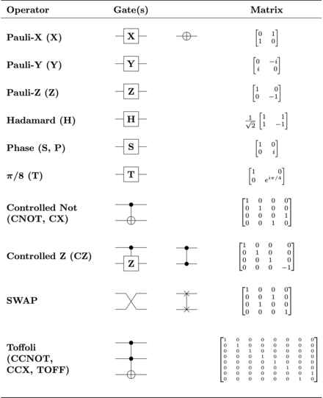
Basic Quantum Gates
Pauli-X, Gates -
Classical NOT analogue
Pauli-Z gate -
Phase flip
Hadamard Gate-
Creates Superposition
CNOT - Key for entanglement
Reversibility-
All quantum gates are reversible.
Qubits cannot be copied
Dirac Notation
bra <0|
ket |0>
Notes:
Introduction to Quantum Gates
Definition:
Quantum gates are the basic building blocks of quantum circuits, similar to classical logic gates in classical computing.
However, unlike classical gates (which operate on bits), quantum gates operate on qubits, allowing them to manipulate quantum states through unitary transformations.
Key Difference from Classical Gates:
Classical gates (AND, OR, NOT) operate deterministically on binary values (0 or 1).
Quantum gates manipulate qubits in superposition, allowing quantum computers to process multiple states simultaneously.
Reversibility: Quantum gates are always reversible (meaning their operations can be undone), unlike some classical gates.
Pauli-X Gate: The Quantum NOT Gate
Function:
The Pauli-X gate is the quantum equivalent of the classical NOT gate.
It flips the state of a qubit: If the qubit is in the |0⟩ state, it will flip it to |1⟩, and vice versa.
Mathematical Representation: X=(0110)X = \begin{pmatrix} 0 & 1 \\ 1 & 0 \end{pmatrix}X=(01​10​)
When applied to a qubit, the Pauli-X gate exchanges the amplitudes of |0⟩ and |1⟩.
Example:
Applying the Pauli-X gate to a qubit in the |0⟩ state results in the |1⟩ state.
If the qubit is in a superposition state, such as ∣ψ⟩=12(∣0⟩+∣1⟩)|ψ⟩ = \frac{1}{\sqrt{2}}(|0⟩ + |1⟩)∣ψ⟩=2​1​(∣0⟩+∣1⟩), applying Pauli-X swaps the components, resulting in 12(∣1⟩+∣0⟩)\frac{1}{\sqrt{2}}(|1⟩ + |0⟩)2​1​(∣1⟩+∣0⟩).
Visual Aid:
Show how the Pauli-X gate rotates a qubit along the x-axis of the Bloch sphere, flipping it between |0⟩ and |1⟩.
Hadamard Gate: Creating Superposition
Function:
The Hadamard gate is one of the most important gates in quantum computing because it creates superposition from a basis state.
When applied to a qubit in the |0⟩ state, the Hadamard gate places the qubit into an equal superposition of |0⟩ and |1⟩: H∣0⟩=12(∣0⟩+∣1⟩)H |0⟩ = \frac{1}{\sqrt{2}} (|0⟩ + |1⟩)H∣0⟩=2​1​(∣0⟩+∣1⟩)
It can also be used to undo superposition and return a qubit back to a basis state.
Mathematical Representation: H=12(111−1)H = \frac{1}{\sqrt{2}} \begin{pmatrix} 1 & 1 \\ 1 & -1 \end{pmatrix}H=2​1​(11​1−1​)
The Hadamard gate evenly distributes the probability amplitudes of a qubit over both the |0⟩ and |1⟩ states.
Example:
If a qubit is in state |0⟩, applying the Hadamard gate creates an equal superposition: H∣0⟩=12(∣0⟩+∣1⟩)H |0⟩ = \frac{1}{\sqrt{2}} (|0⟩ + |1⟩)H∣0⟩=2​1​(∣0⟩+∣1⟩)
Similarly, applying it to the |1⟩ state results in: H∣1⟩=12(∣0⟩−∣1⟩)H |1⟩ = \frac{1}{\sqrt{2}} (|0⟩ - |1⟩)H∣1⟩=2​1​(∣0⟩−∣1⟩)
Visual Aid:
Show how the Hadamard gate rotates a qubit on the Bloch sphere halfway between the x-axis and the z-axis, moving it into a superposition of states.
Pauli-Z Gate: Phase Flip
Function:
The Pauli-Z gate is a phase-flip gate. It leaves the |0⟩ state unchanged but applies a π phase shift (i.e., a 180-degree rotation) to the |1⟩ state, flipping its phase.
This changes the relative phase between the components of a superposition state, which is crucial for algorithms relying on interference.
Mathematical Representation: Z=(100−1)Z = \begin{pmatrix} 1 & 0 \\ 0 & -1 \end{pmatrix}Z=(10​0−1​)
The Pauli-Z gate flips the sign of the |1⟩ component of a qubit’s state, but leaves the |0⟩ component unchanged.
Example:
For a qubit in the state ∣ψ⟩=12(∣0⟩+∣1⟩)|ψ⟩ = \frac{1}{\sqrt{2}}(|0⟩ + |1⟩)∣ψ⟩=2​1​(∣0⟩+∣1⟩), applying the Pauli-Z gate results in: Z∣ψ⟩=12(∣0⟩−∣1⟩)Z |ψ⟩ = \frac{1}{\sqrt{2}}(|0⟩ - |1⟩)Z∣ψ⟩=2​1​(∣0⟩−∣1⟩)
This phase flip is important for algorithms that rely on quantum interference.
Visual Aid:
Illustrate how the Pauli-Z gate rotates the qubit around the z-axis on the Bloch sphere, affecting only the phase of the state.
Controlled-NOT (CNOT) Gate: Two-Qubit Entangling Operation
Function:
The CNOT gate (Controlled-NOT) operates on two qubits: a control qubit and a target qubit.
The gate flips the state of the target qubit if the control qubit is in the |1⟩ state, and does nothing if the control qubit is in the |0⟩ state.
The CNOT gate is crucial for creating entanglement between qubits, which is essential for many quantum algorithms.
Mathematical Representation: CNOT=(1000010000010010)CNOT = \begin{pmatrix} 1 & 0 & 0 & 0 \\ 0 & 1 & 0 & 0 \\ 0 & 0 & 0 & 1 \\ 0 & 0 & 1 & 0 \end{pmatrix}CNOT=​1000​0100​0001​0010​​
This matrix flips the target qubit if the control qubit is in the |1⟩ state.
Example:
If the control qubit is in the |1⟩ state and the target qubit is in the |0⟩ state, applying the CNOT gate will flip the target qubit to |1⟩. However, if the control qubit is in the |0⟩ state, the target qubit remains unchanged.
Entanglement Creation:
The CNOT gate is key to creating entanglement. For example, applying a CNOT gate to a pair of qubits in a superposition can create an entangled state, such as a Bell state: 12(∣00⟩+∣11⟩)\frac{1}{\sqrt{2}}(|00⟩ + |11⟩)2​1​(∣00⟩+∣11⟩)
Visual Aid:
Use an illustration of a quantum circuit with a CNOT gate, showing how the control qubit influences the target qubit.
How Quantum Gates Are Used in AI Applications
Manipulating Superposition and Entanglement:
Quantum gates like Hadamard and CNOT are used to manipulate qubits in superposition and entanglement, which is crucial for quantum AI algorithms.
Example in AI:
In quantum machine learning, gates like the Hadamard gate help create superposition across multiple qubits, enabling simultaneous exploration of different model configurations during the training process.
The CNOT gate is essential for creating the entangled states needed for quantum parallelism in tasks like data clustering and optimization.
Recap & Transition
Recap:
The Pauli-X gate flips qubits like a NOT gate.
The Hadamard gate creates superposition, a key ingredient for quantum parallelism.
The Pauli-Z gate alters phase, crucial for interference.
The CNOT gate entangles qubits, enabling complex multi-qubit operations.
Transition:
In the next slide, we’ll explore why quantum gates and their operations can lead to quantum speedup in AI tasks, particularly optimization and search algorithms.

Slide 8
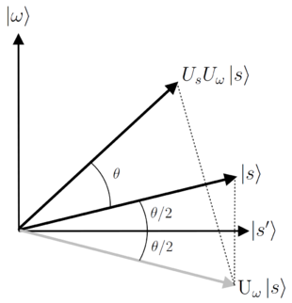
Applications in AI
Instantaneous Hyperparameter search with functions like Grover's Algorithm.
Complex Optimization
High-dimensional data processing with quantum entanglement and superposition
Current Applications:
1QBit pattern recognition for portfolio perfromance
D-Wave Quantum Annealer for supply chains
ProteinQure for drug discovery
CQC quantum enhanced NLP
Toshiba quantum-secured networks
Notes:
How Quantum Computing Enhances AI Tasks
1. Speeding Up Model Training
Current Challenge: Classical AI models often require extensive trial and error to find the best parameters (hyperparameter tuning) and can take significant amounts of time to train, especially on large datasets.
Quantum Solution:
Quantum algorithms like Grover’s search can explore large parameter spaces exponentially faster than classical search algorithms.
Quantum computers can leverage superposition to evaluate multiple potential configurations simultaneously, speeding up the process of finding optimal solutions in model training.
Real-world Impact:
This could cut down the time needed for training deep learning models from days or weeks to hours or minutes, especially for complex tasks like natural language processing (NLP) and image recognition.
2. Solving Complex Optimization Problems
Current Challenge: Many AI applications, such as resource allocation, route planning, and decision-making, involve combinatorial optimization problems, which are notoriously difficult for classical computers.
Quantum Solution:
Quantum algorithms, such as the Quantum Approximate Optimization Algorithm (QAOA), are specifically designed to solve these complex problems much faster than classical algorithms.
Quantum computers can efficiently explore large, combinatorial search spaces by using quantum parallelism to evaluate multiple solutions at once.
Real-world Impact:
AI applications in fields like supply chain optimization, financial portfolio management, and autonomous systems could see exponential improvements in decision-making speed and accuracy.
3. Tackling High-Dimensional Data
Current Challenge: Classical AI systems struggle with high-dimensional data because it is computationally expensive to process and often leads to overfitting or underfitting in models.
Quantum Solution:
Quantum computers can process high-dimensional data more efficiently by leveraging quantum entanglement and superposition, which allows them to capture correlations in data that classical systems might miss.
Quantum kernel methods are being developed to process high-dimensional data spaces and can outperform classical kernel-based learning techniques.
Real-world Impact:
This is especially useful in fields like drug discovery, where data often comes in the form of complex molecular interactions or high-dimensional gene expression datasets, which classical systems find difficult to analyze.
Potential Use Cases for Quantum AI
1. Drug Discovery:
Problem: Drug discovery involves searching through massive chemical spaces to find effective treatments, a process that is time-consuming and expensive.
Quantum Impact: Quantum computers can model molecular interactions far more accurately and efficiently than classical computers, accelerating the discovery of new drugs and reducing the time to market.
2. Natural Language Processing (NLP):
Problem: Current NLP models, like GPT or BERT, require vast computational resources to train and fine-tune.
Quantum Impact: By using quantum-enhanced algorithms, NLP systems could explore larger context windows and more complex linguistic patterns, improving language understanding and reducing the cost of training large models.
3. Financial Modeling & Risk Analysis:
Problem: Classical algorithms struggle with accurately modeling complex financial systems, especially when there is a lot of uncertainty or interdependence between variables.
Quantum Impact: Quantum computers could provide better predictions for financial markets by using quantum algorithms to model uncertainty and optimize portfolios more effectively.
Why Quantum AI Now?
Technological Progress:
We’re in the early stages of quantum computing, but recent breakthroughs in quantum hardware and algorithms are bringing us closer to practical quantum applications in AI.
Major tech companies like Google, IBM, and Microsoft are investing heavily in quantum AI research, with the goal of achieving quantum advantage in AI within the next decade.
Quantum Supremacy and NISQ:
While we’re still in the Noisy Intermediate Scale Quantum (NISQ) era, meaning quantum computers are not yet powerful enough to solve all problems, significant progress is being made.
In the near term, hybrid quantum-classical systems could deliver performance improvements in AI tasks by combining the strengths of both classical and quantum systems.
Whet the Appetite: What's Next in Quantum AI?
Ongoing Research:
Cutting-edge work is focused on developing quantum neural networks (QNNs) and quantum machine learning algorithms that can outperform classical neural networks in specific tasks.
Exciting research into quantum graph neural networks (QGNNs) promises to revolutionize how we process and analyze graph-structured data, a key aspect of many AI applications today.
Future Horizons:
Quantum AI could redefine industries like healthcare, finance, and autonomous systems.
The potential for faster, more accurate decision-making and problem-solving opens the door to new AI capabilities that were previously out of reach for classical computers.
1. Quantum Machine Learning (QML) for Pattern Recognition
Problem: AI systems need to recognize patterns in massive datasets—common in fields like image recognition, speech processing, and recommendation systems.
Quantum Solution:
Quantum machine learning (QML) algorithms, such as the Quantum Support Vector Machine (QSVM), are being developed to handle pattern recognition more efficiently.
Quantum computers can leverage quantum kernels to process high-dimensional data more effectively than classical systems.
Current Use:
Companies like D-Wave are using quantum-inspired algorithms to enhance image recognition systems and detect anomalies in large datasets.
Real-World Example:
A startup, 1QBit, works with quantum-inspired approaches for portfolio optimization and pattern recognition in finance, demonstrating the commercial viability of QML even with today’s limited quantum resources.
2. Optimization Problems in Supply Chains and Logistics
Problem: Many AI tasks, especially in supply chain management and logistics, involve solving complex optimization problems, such as route planning and resource allocation.
Quantum Solution:
Quantum algorithms like the Quantum Approximate Optimization Algorithm (QAOA) offer more efficient solutions to combinatorial optimization problems.
Quantum systems can explore vast solution spaces faster than classical methods, making them ideal for logistics optimization and inventory management.
Current Use:
Volkswagen and DHL are exploring quantum computing for optimizing traffic flow in large cities and logistics networks, aiming to improve efficiency and reduce operational costs.
Real-World Example:
Volkswagen is using D-Wave’s quantum annealer to optimize traffic patterns in urban environments, reducing congestion and improving the efficiency of public transportation systems in Lisbon and Beijing.
3. Drug Discovery and Healthcare
Problem: Drug discovery involves searching through large chemical spaces to identify compounds with potential therapeutic effects, which is computationally expensive and time-consuming.
Quantum Solution:
Quantum computers can simulate molecular interactions far more accurately than classical systems by modeling quantum mechanical interactions directly.
Quantum chemistry algorithms, like the Variational Quantum Eigensolver (VQE), can predict molecular properties and binding affinities, helping accelerate drug discovery.
Current Use:
Biotech companies like ProteinQure and Cambridge Quantum Computing (CQC) are using quantum algorithms for drug discovery, especially for designing novel proteins and molecular compounds.
Real-World Example:
Bayer and Google are partnering to apply quantum algorithms to molecular simulations for drug discovery, aiming to reduce the time and cost of bringing new drugs to market.
4. Financial Services: Portfolio Optimization and Risk Analysis
Problem: Financial models often need to handle a large number of variables with significant interdependencies, making it difficult to optimize portfolios or assess risk accurately.
Quantum Solution:
Quantum computers can efficiently solve portfolio optimization problems by leveraging quantum algorithms to search vast solution spaces for optimal asset allocations.
Quantum Monte Carlo algorithms are also being developed to improve risk assessment by providing more accurate predictions based on quantum probabilistic models.
Current Use:
Goldman Sachs and JPMorgan are experimenting with quantum algorithms to enhance portfolio management and risk analysis models.
Real-World Example:
JPMorgan has partnered with IBM to explore how quantum computers can improve the efficiency of Monte Carlo simulations for risk modeling, potentially offering more accurate predictions in volatile markets.
5. Natural Language Processing (NLP) and Quantum NLP
Problem: NLP tasks, such as speech recognition, translation, and sentiment analysis, involve processing and interpreting vast amounts of linguistic data, which is computationally intensive.
Quantum Solution:
Researchers are exploring quantum natural language processing (QNLP), using quantum circuits to represent and process linguistic information.
The inherent parallelism of quantum computing allows it to process complex patterns in language more efficiently than classical methods, particularly in semantic analysis.
Current Use:
Cambridge Quantum Computing (CQC) is developing quantum-enhanced NLP algorithms, which could lead to improvements in AI’s ability to understand and generate natural language.
Real-World Example:
CQC has developed a framework for quantum natural language processing, aiming to bring quantum computing into mainstream NLP tasks like machine translation and question answering systems.
6. Quantum-Enhanced AI for Cybersecurity
Problem: As data becomes more valuable and attacks more sophisticated, ensuring secure encryption and data protection becomes a critical AI task in cybersecurity.
Quantum Solution:
Quantum algorithms can improve AI models used in intrusion detection, threat analysis, and encryption.
Quantum key distribution (QKD) offers unbreakable encryption based on the principles of quantum mechanics, ensuring secure communication networks.
Current Use:
Companies like ID Quantique are already using quantum key distribution (QKD) to enhance the security of encrypted communication channels, with applications in AI-driven threat detection and secure data transmission.
Real-World Example:
BT Group and Toshiba are collaborating on quantum-secured AI networks using quantum encryption to prevent data breaches and cyberattacks in financial services.

Slide 9
Session 1 Summary
Quantum Computing Basics:
Qubits can exist in superposition, allowing quantum computers to process multiple states simultaneously, leading to potential exponential speedups over classical computers.
Entanglement enables qubits to be correlated over distances, enhancing the efficiency of quantum operations.
Quantum Gates:
Pauli-X (NOT), Hadamard, and CNOT gates are essential for manipulating qubits in superposition and creating entanglement, enabling powerful quantum operations.
These gates are key components in quantum algorithms that can solve complex problems more efficiently than classical algorithms.
Potential in AI:
Quantum computing can dramatically accelerate AI tasks like model training, optimization, and high-dimensional data processing.
Current Applications include drug discovery, financial modeling, supply chain optimization, and natural language processing (NLP), often using hybrid quantum-classical systems.
Real-World Use Cases:
Companies like Volkswagen, Bayer, JPMorgan, and Google are exploring quantum-enhanced solutions for traffic optimization, drug discovery, financial risk analysis, and portfolio optimization.
The Future of Quantum AI:
Research is progressing on quantum machine learning (QML) and quantum neural networks (QNNs), with a focus on solving previously intractable AI problems.

Slide 11
Quantum AI Mini Seminar Series:
Session 2: Quantum Algorithms and their Potential for AI
Quantum Algorithms for AI
Grover's Search Algorithm
Quantum Fourier Transform
Quantum Speedup
Other Quantum Algorithms
AI application of Quantum Algorithms

Slide 12
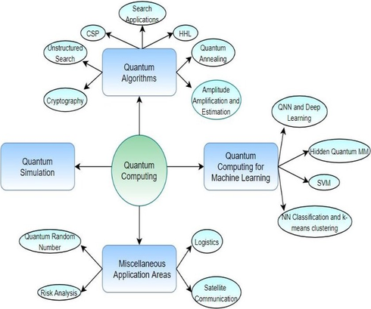
Quantum Algorithms for AI
Key Principles
Superposition
Entanglement
Interference
Phase
Amplitude
Potential for Speedup
From quadratic to exponential speedup
Notes:
Key Principles
Superposition
Description: In classical computing, bits can be in one of two definite states, 0 or 1. In quantum computing, qubits can exist in a combination of both states simultaneously, known as superposition.
Mathematics: A qubit in superposition is represented as: ∣ψ⟩=α∣0⟩+β∣1⟩|\psi\rangle = \alpha |0\rangle + \beta |1\rangle∣ψ⟩=α∣0⟩+β∣1⟩ where α\alphaα and β\betaβ are complex probability amplitudes, with the condition that ∣α∣2+∣β∣2=1|\alpha|^2 + |\beta|^2 = 1∣α∣2+∣β∣2=1. The qubit is in a linear combination of the 0 and 1 states, and when measured, it collapses to either 0 or 1 based on these probabilities.
Relevance: Superposition enables quantum algorithms to explore multiple possibilities in parallel, drastically increasing computational efficiency for certain tasks, such as searching or optimization in AI.
Entanglement
Description: Entanglement is a unique quantum phenomenon where the state of one qubit becomes dependent on the state of another, regardless of the distance between them.
Mathematics: If two qubits are entangled, the state of the system is described by a joint wavefunction: ∣ψ⟩=12(∣00⟩+∣11⟩)|\psi\rangle = \frac{1}{\sqrt{2}} \left( |00\rangle + |11\rangle \right)∣ψ⟩=2​1​(∣00⟩+∣11⟩) Measuring one qubit immediately determines the state of the other, no matter how far apart they are. This is not possible in classical systems.
Relevance: Entanglement allows for correlations across qubits that classical bits cannot achieve, enabling faster information sharing and quantum parallelism. It is key in quantum communication and some quantum algorithms, such as Grover’s and Shor’s.
Interference
Description: In quantum systems, interference occurs when quantum states interact, either amplifying or canceling each other out. This is analogous to how waves interfere.
Mathematics: Quantum interference is governed by the amplitudes of the wavefunction. Constructive interference increases the probability of measuring correct solutions, while destructive interference reduces the probability of incorrect solutions.
Relevance: Interference is crucial in quantum algorithms. For instance, in Grover’s algorithm, interference is used to amplify the probability of finding the correct solution and suppress incorrect ones, leading to a faster search process.
Phase
Description: Phase is a critical property in quantum mechanics, representing the angle of the wavefunction. It is not just the magnitude of the quantum state that matters but also its phase relative to other states.
Mathematics: The phase of a quantum state can be written as eiθe^{i\theta}eiθ, where θ\thetaθ represents the phase angle. The total wavefunction is: ∣ψ⟩=αeiθ0∣0⟩+βeiθ1∣1⟩|\psi\rangle = \alpha e^{i\theta_0} |0\rangle + \beta e^{i\theta_1} |1\rangle∣ψ⟩=αeiθ0​∣0⟩+βeiθ1​∣1⟩ Phase differences between qubits influence how they interfere with one another.
Relevance: Phase manipulation is crucial for algorithms like the Quantum Fourier Transform (QFT) and Quantum Phase Estimation, which are used in AI for optimization and signal processing tasks.
Amplitude
Description: Amplitude in quantum mechanics represents the likelihood of a quantum state. When squared, it gives the probability of measuring a particular state.
Mathematics: For a state ∣ψ⟩=α∣0⟩+β∣1⟩|\psi\rangle = \alpha |0\rangle + \beta |1\rangle∣ψ⟩=α∣0⟩+β∣1⟩, the probability of measuring ∣0⟩|0\rangle∣0⟩ is ∣α∣2|\alpha|^2∣α∣2, and the probability of measuring ∣1⟩|1\rangle∣1⟩ is ∣β∣2|\beta|^2∣β∣2.
Relevance: Quantum algorithms often aim to increase the amplitude of desired states through amplitude amplification. For example, in Grover’s algorithm, the amplitude of the correct solution grows with each iteration, improving the probability of success.
Potential for Speedup
Quadratic Speedup:
Description: Quantum algorithms can offer quadratic speedup compared to classical algorithms. A prime example is Grover’s algorithm, which reduces the time complexity of an unstructured search from O(N)O(N)O(N) in classical systems to O(N)O(\sqrt{N})O(N​) in quantum systems.
Relevance in AI: This quadratic speedup is particularly useful in AI tasks like hyperparameter tuning, combinatorial search, and data mining, where large solution spaces need to be explored efficiently.
Exponential Speedup:
Description: Some quantum algorithms, such as Shor’s algorithm for integer factorization, offer exponential speedup over classical counterparts. Shor’s algorithm runs in O((log⁡N)3)O((\log N)^3)O((logN)3) time, compared to the best-known classical algorithm, which runs in super-polynomial time.
Relevance in AI: Exponential speedups can dramatically impact AI areas that require solving problems like cryptography, optimization, and machine learning model training. For example, tasks that would take millions of years to solve classically could be completed in seconds on a sufficiently powerful quantum computer.
Quantum Machine Learning (QML): Quantum Speedup also extends to potential exponential improvements in specific machine learning tasks, such as quantum-enhanced support vector machines (QSVM) and quantum neural networks, which could outperform their classical counterparts by learning and processing data more efficiently.

Slide 13
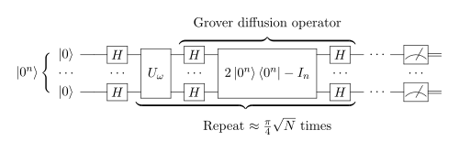
Grover's Search Algorithm
Geometric Interpretation
Algorithm stays in 2D subspace (|s>, |w>)
U_{s} and U_{w} are reflections through |s>, |w>
Each rotation, 𝜃= 2 arcsin(1/N^{1/2})
Iterations move the state towards |w>
O(𝜋N^{1/2}/2)-->O(N^{1/2})
Quadratic Speedup over Classical Search
Crucial to Hyperparameter optimization in AI
WolframAlpha, Grover's
Notes:
Classical Search Problem:
In a classical search, finding a specific element in an unstructured database of NNN elements requires an average of O(N)O(N)O(N) queries.
This is because, without any structure, the best classical algorithm can only check one element at a time. This linear search requires, on average, N/2N/2N/2 queries to find the target element.
Grover’s Quadratic Speedup:
Grover’s algorithm reduces the search complexity to O(√N) by exploiting quantum superposition and amplitude amplification. This is a quadratic speedup over classical search algorithms, which is significant when NNN is large.
Grover’s algorithm starts with a uniform superposition of all possible states: ∣s⟩=1N∑x=0N−1∣x⟩|s\rangle = \frac{1}{\sqrt{N}} \sum_{x=0}^{N-1} |x\rangle∣s⟩=N​1​x=0∑N−1​∣x⟩
In this state, each element in the database is equally likely to be the solution.
The algorithm uses two key quantum operations:
Oracle UωU_{\omega}Uω​: Marks the correct solution ∣ω⟩|\omega\rangle∣ω⟩ by flipping its phase. It is essentially a reflection around the hyperplane orthogonal to the solution state.
Diffusion Operator UsU_sUs​: Reflects the current state about the average amplitude of all states, amplifying the amplitude of the correct solution ∣ω⟩|\omega\rangle∣ω⟩.
Geometric Interpretation:
Grover’s algorithm can be visualized geometrically in a 2D subspace spanned by ∣s⟩|s\rangle∣s⟩ (the initial state) and ∣ω⟩|\omega\rangle∣ω⟩ (the solution state).
Each iteration of Grover’s algorithm rotates the quantum state toward ∣ω⟩|\omega\rangle∣ω⟩ by an angle θ\thetaθ, where: θ=2arcsin⁡(1N)\theta = 2 \arcsin \left( \frac{1}{\sqrt{N}} \right)θ=2arcsin(N​1​)
The number of iterations rrr required to reach the solution is approximately r≈π4Nr \approx \frac{\pi}{4} \sqrt{N}r≈4π​N​. After this, the quantum state is close enough to ∣ω⟩|\omega\rangle∣ω⟩ that measuring the state yields the correct solution with high probability.
Quantum Operators in Grover’s Algorithm:
The oracle UωU_{\omega}Uω​ is a reflection operator: Uω=I−2∣ω⟩⟨ω∣U_{\omega} = I - 2 |\omega\rangle \langle \omega|Uω​=I−2∣ω⟩⟨ω∣
This operation flips the phase of the state ∣ω⟩|\omega\rangle∣ω⟩, marking it as the correct solution.
The diffusion operator UsU_sUs​ reflects around the average amplitude: Us=2∣s⟩⟨s∣−IU_s = 2 |s\rangle \langle s| - IUs​=2∣s⟩⟨s∣−I
This increases the amplitude of the state ∣ω⟩|\omega\rangle∣ω⟩ and decreases the amplitude of the other states.
Application in AI:
In AI, Grover’s algorithm can be used to speed up search tasks that are computationally expensive, such as hyperparameter tuning in machine learning models or combinatorial search problems.
For instance, in a large search space of potential hyperparameters, Grover’s algorithm can reduce the number of evaluations needed to find the optimal set of parameters.
Similarly, it can be applied in data mining or pattern recognition tasks, where searching through a large, unstructured dataset is required.
Probability of Success:
After rrr iterations, the state vector is rotated close to ∣ω⟩|\omega\rangle∣ω⟩, and the probability of measuring the correct answer is maximized.
The probability of success is given by: sin⁡2((r+12)θ)\sin^2 \left( \left( r + \frac{1}{2} \right) \theta \right)sin2((r+21​)θ)
To maximize the probability of success, the number of iterations should be carefully chosen to ensure the state vector is close to the desired solution state.
Limitation and Optimality:
While Grover’s algorithm provides a quadratic speedup, it is not exponential. It is optimal for unstructured search problems but does not outperform classical algorithms in problems that have inherent structure.
However, in cases where brute-force search is the only viable classical approach, Grover’s algorithm can provide a significant advantage, especially for large NNN.

Slide 14
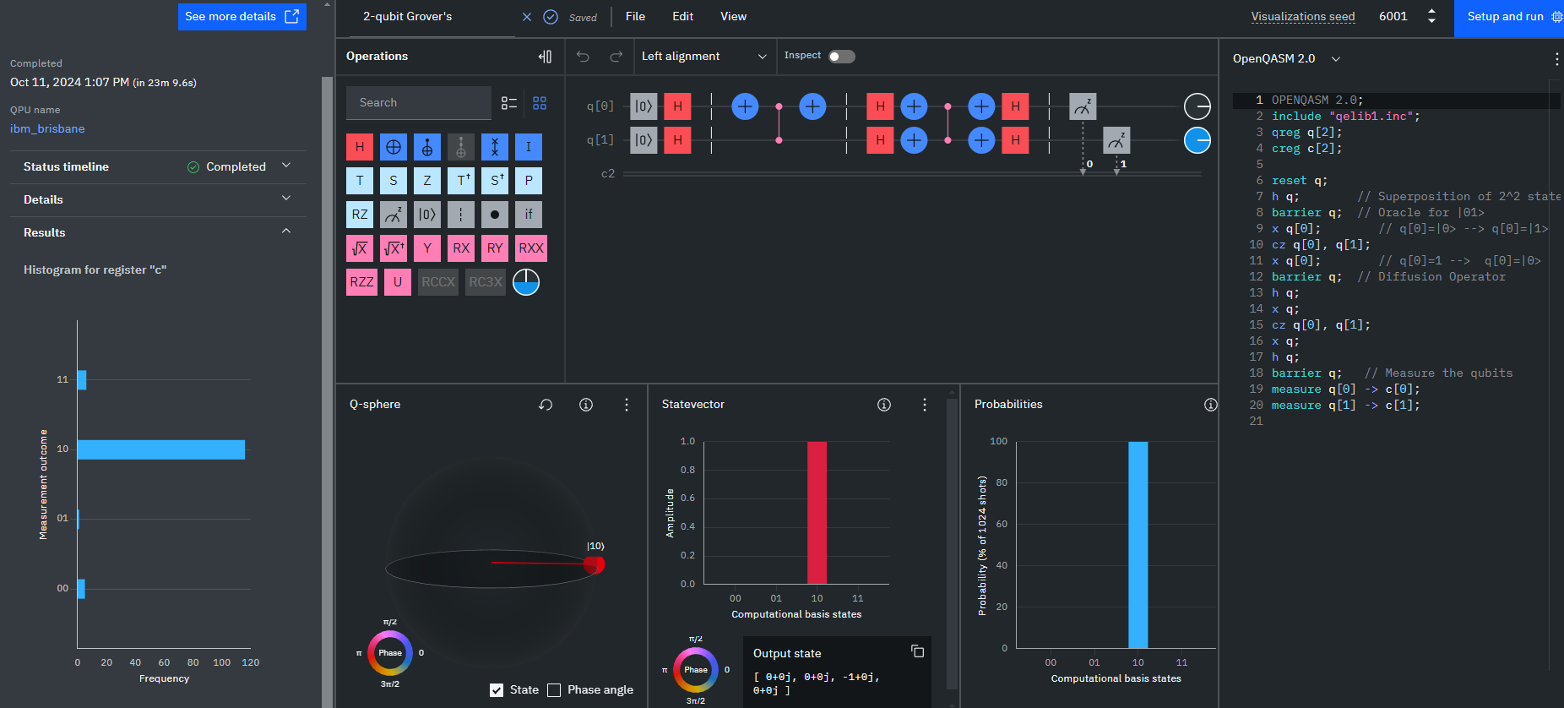

Slide 15
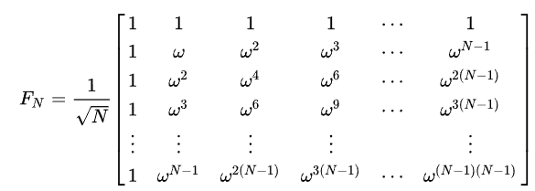
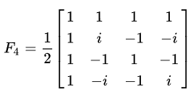
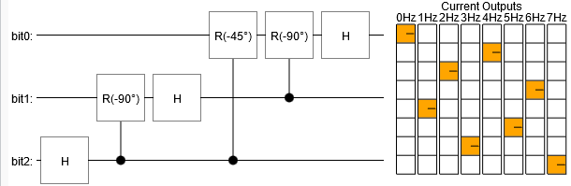
Quantum Fourier Transform (QFT)
Basis Transformation between computational and Fourier States
Maps state to
Used in Quantum Phase Estimation
AI: Cost Function Optimization and signal processing
Notes:
Speaker’s Notes:
Basis Transformation: The Quantum Fourier Transform (QFT) is a quantum analog of the classical Fourier transform. It transforms quantum states from the computational basis (where qubits are represented by binary numbers) to the Fourier basis, which is useful in many quantum algorithms. The key feature of QFT is that it maps a quantum state ∣x⟩|x\rangle∣x⟩ to a superposition of states in the Fourier basis.
Mapping States:
The QFT maps a state ∣x⟩|x\rangle∣x⟩ into a superposition of Fourier basis states as follows: ∣x⟩→1N∑k=0N−1e2πixk/N∣k⟩|x\rangle \rightarrow \frac{1}{\sqrt{N}} \sum_{k=0}^{N-1} e^{2\pi ixk/N} |k\rangle∣x⟩→N​1​k=0∑N−1​e2πixk/N∣k⟩
This transformation is pivotal in algorithms where periodicity or phase information is important. You can show this with a visualization of the state mapping, showing how the computational state is spread across the Fourier basis after the transformation.
Quantum Phase Estimation:
One of the most important applications of the QFT is in Quantum Phase Estimation, an algorithm that determines the eigenvalue (phase) associated with an eigenvector of a unitary operator. The QFT is used at the final step of this algorithm to extract the phase information from the quantum state.
Show an equation that highlights how QFT is used to measure the phase: ∣ψ⟩=∑k=0N−1e2πiθk∣k⟩|\psi\rangle = \sum_{k=0}^{N-1} e^{2\pi i\theta k}|k\rangle∣ψ⟩=k=0∑N−1​e2πiθk∣k⟩
In AI, phase estimation can assist in solving optimization problems where periodicity or phase information is needed, especially in systems that model complex interactions or cost functions.
AI Applications:
The QFT can be applied in cost function optimization in machine learning algorithms. For instance, in certain AI models where the cost function is periodic or non-linear, the QFT can help in identifying the optimal parameters by transforming the problem into the frequency domain.
Another application is in signal processing for AI systems. For example, AI models that deal with time-series data, audio analysis, or sensor data could use QFT to filter noise or extract relevant signal frequencies more efficiently than classical Fourier transforms.

Slide 16
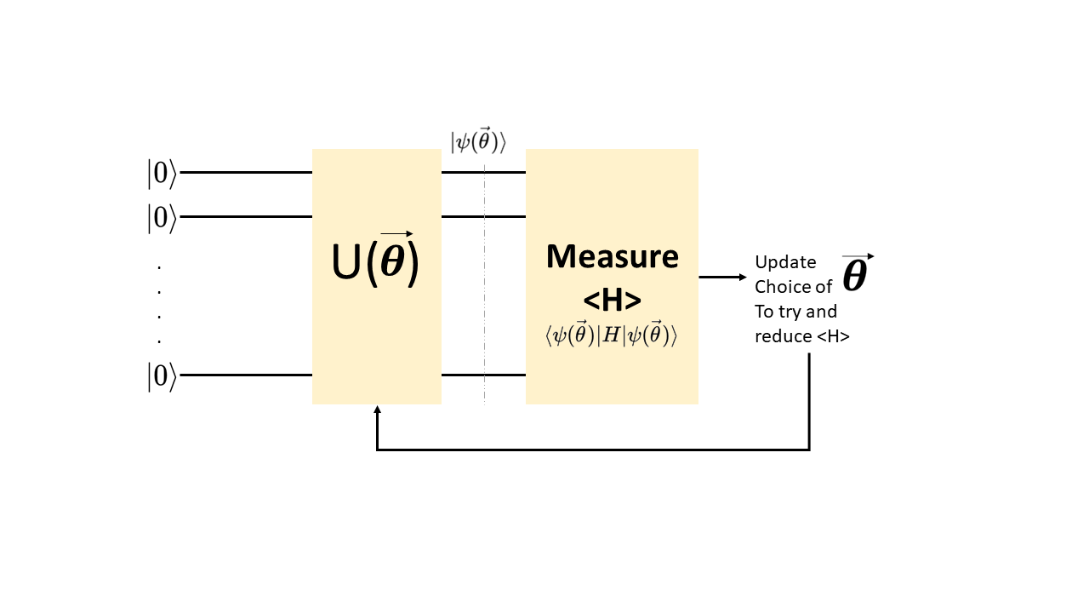
More Quantum Algorithms for AI
Grover’s algorithm: Speedup in search and optimization
QFT: Enhances signal processing and pattern recognition
QAOA: Combinatorial optimization for logistics, scheduling
VQE: Non-convex optimization for AI models
Quantum Walks: Faster graph traversal and node ranking
QSVM: Speedup in classification and machine learning tasks
Notes:
Grover’s algorithm is highly effective for reducing the time required for search and optimization problems in AI, which are common in model training and data mining.
QFT improves signal processing tasks in AI, particularly in systems that rely on time-series analysis or pattern recognition.
QAOA (Quantum Approximate Optimization Algorithm) addresses combinatorial optimization problems seen in logistics or scheduling, providing faster solutions than classical methods.
VQE (Variational Quantum Eigensolver) is useful for non-convex optimization, applicable to AI models that require minimizing complex loss functions.
Quantum Walks provide faster methods for graph traversal, essential for AI applications that work with network-based data like social graphs or recommendation systems.
QSVM (Quantum Support Vector Machine) enhances traditional SVMs by using quantum kernels to accelerate classification tasks.

Slide 17
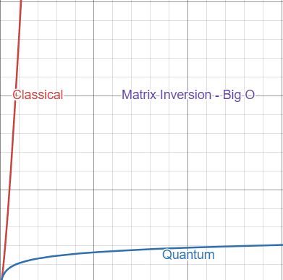
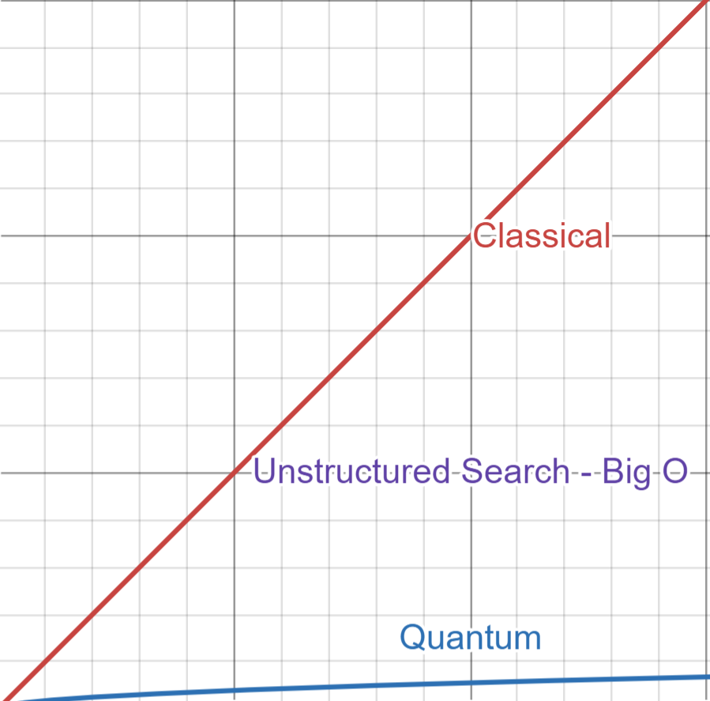
Quantum Speedup
Superposition: Evaluates multiple states in parallel
Allows simultaneous exploration of solution space
Interference: Enhances correct solutions
Amplifies desired outcomes, reduces errors
Quantum Speedup: Reduces complexity in AI tasks
Significant reduction in time for search, optimization
Notes:
Superposition: Quantum computers leverage superposition, where qubits can exist in a combination of states (0 and 1), enabling the system to evaluate many possible solutions in parallel. This allows for a more efficient exploration of the solution space compared to classical algorithms.
Interference: Through quantum interference, the algorithm amplifies the probabilities of correct solutions while suppressing incorrect ones. This constructive and destructive interference is a key advantage of quantum systems over classical systems, which don't have this mechanism to accelerate convergence toward correct answers.
Quantum Speedup: The combined effect of superposition and interference leads to speedups in various AI tasks, especially in optimization and search problems. For example, Grover’s algorithm achieves quadratic speedup (O(√N)) in search tasks, while other algorithms like QAOA and VQE optimize large solution spaces more efficiently than classical methods

Slide 18
Session 2 Summary
Grover’s, QFT, QAOA, VQE, and QSVM applications in AI
Speedups in search, optimization, signal processing, and classification
Quantum Walks, and QVSM

Slide 20
Quantum AI Mini Seminar Series:
Session 2: Quantum Machine Learning
Overview
Variational Quantum Eigensolver
Quantum Approximate Optimization Algorithm (QAOA)
Data Encoding in Quantum Systems
Challenges in Quantum AI

Slide 21
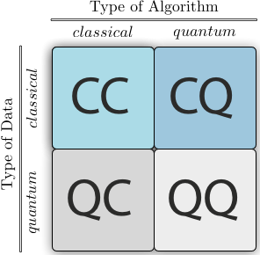
Overview
Quantum Machine Learning
Applications
Classification: QSVM
Optimization: VQE, QAOA
Pattern Recognition: Quantum Clustering
Capabilities
Four different approaches to combine the disciplines of quantum computing and machine learning.
Notes:
Definition of QML:
QML is the integration of quantum mechanics into machine learning models to solve complex problems with enhanced speed and efficiency.
Applications in ML Tasks:
Classification: Quantum Support Vector Machines (QSVM).
Optimization: Algorithms like VQE and QAOA reduce steps in cost function minimization.
Clustering and Pattern Recognition: Quantum-based clustering shows promise for high-dimensional data analysis.
Potential Impact on Machine Learning:
Enhanced processing power for complex models.
Parallelism allows evaluation of multiple states at once.
May reduce computation times for optimization, data processing, and training tasks.
Session Focus:
Key QML algorithms: Variational Quantum Eigensolver (VQE), Quantum Approximate Optimization Algorithm (QAOA).
Data encoding methods in quantum systems.
Current challenges limiting quantum computing in AI.

Slide 22
Variational Quantum Eigensolver (VQE)
Hybrid Algorithm
Initialize paprameters (θ)
Layers of rotation/entangling gates
Quamtum measurement
Classical Optimization
Repeat until convergence onmin eigval
Suitable for optimizing neural network hyperparameters.
Quantum Module
Quantum Module
Classical Adder
Quantum State Preparation
Classical Feedback Decision
Quantum Module
…
Quantum Module
Notes:
VQE Overview:
Hybrid Algorithm: Combines quantum processing and classical optimization to solve for the lowest eigenvalue of a Hamiltonian.
Used in optimization problems, analogous to finding the minimum of a cost function in AI.
How VQE Works:
Parameterized Quantum Circuit:
Initialize parameters θ={θ1,θ2,…,θn}\theta = \{\theta_1, \theta_2, \ldots, \theta_n\}θ={θ1​,θ2​,…,θn​}.
Circuit structure: Layers of rotation gates and entangling gates.
Quantum Measurement:
Evaluate ⟨ψ(θ)∣H∣ψ(θ)⟩\langle \psi(\theta) | H | \psi(\theta) \rangle⟨ψ(θ)∣H∣ψ(θ)⟩ for cost function.
Classical Optimization:
Adjust parameters θ\thetaθ to minimize the cost function with classical optimizers (e.g., gradient descent).
Repeat until convergence on minimum eigenvalue.
Circuit Example:
Circuit Layout: Alternating layers of single-qubit rotation gates and CNOT gates for entanglement.
Equation for Expectation: E(θ)=⟨ψ(θ)∣H∣ψ(θ)⟩E(\theta) = \langle \psi(\theta) | H | \psi(\theta) \rangleE(θ)=⟨ψ(θ)∣H∣ψ(θ)⟩
Goal: Minimize E(θ)E(\theta)E(θ) to approximate the ground state energy.
AI Application:
VQE can be applied to optimize neural networks by encoding network parameters in the quantum circuit.
Uses fewer steps for cost function minimization than classical methods, potentially speeding up training times.

Slide 23
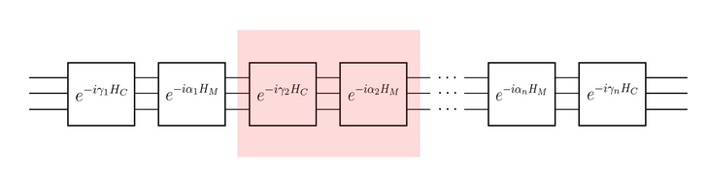
Quantum Approximate Optimization Algorithm (QAOA)
Algorithm
Initialize parameters β and γ: Define layers based on problem
Two-step cirucit
Phase Operator
Mising Operator
Iterate Parameters to maximize solution probability
Well-suited for graph-based optimization
Notes:
QAOA Overview:
Objective: Approximate solutions for combinatorial optimization problems.
Uses a parameterized quantum circuit to iteratively adjust solution probabilities.
Algorithm Steps:
Initialize Parameters β\betaβ and γ\gammaγ:
Define layers based on the optimization problem.
Two-Step Circuit:
Phase Operator: Applies constraints of the problem, rotating by γ\gammaγ.
Mixing Operator: Rotates state with parameter β\betaβ, exploring other potential solutions.
Iterate Parameters:
Adjust β\betaβ and γ\gammaγ to maximize probability of finding optimal solution.
Circuit Structure:
Phase Separation Layer: Applies e−iγHe^{-i \gamma H}e−iγH to encode constraints.
Mixing Layer: Applies e−iβBe^{-i \beta B}e−iβB to mix states, encouraging exploration.
AI Application:
QAOA is well-suited for graph-based optimization in AI, including tasks like graph partitioning, scheduling, and route optimization.
Faster than classical algorithms for problems with complex constraints.

Slide 24
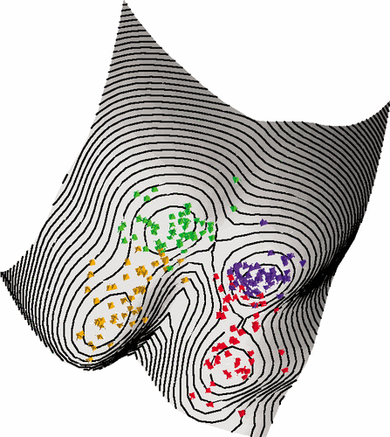
Quantum Clustering
Quantum Clustering
Amplitude Encoding
Distance Measurement
Entanglement
Dynamic Quantum Clustering
Continuously adapts clusters
Field gradient evolutions
Wavefunction representation
Limited Basis Appraoch
Limits number of basis states
Conserves resoureces
Notes:
Quantum Clustering Overview:
Quantum clustering involves mapping data points into quantum states to perform clustering with quantum principles like superposition and entanglement.
Each data point is represented as a quantum state ∣x⟩|x\rangle∣x⟩ in a high-dimensional Hilbert space. Clusters are then identified by measuring the similarities between these states.
Quantum clustering algorithms are effective for high-dimensional data and complex clustering problems where traditional clustering methods are computationally expensive.
How Quantum Clustering Works:
Amplitude Encoding: Encodes each data point as an amplitude vector in a quantum state: ∣x⟩=∑i=0N−1xi∣i⟩|x\rangle = \sum_{i=0}^{N-1} x_i |i\rangle∣x⟩=i=0∑N−1​xi​∣i⟩
Distance Measurement: The overlap (or fidelity) between quantum states can be used as a measure of similarity. The closer two states are in the Hilbert space, the more likely they belong to the same cluster.
Entanglement for Multi-dimensional Relations: Entanglement can be used to create relationships across multiple features, making clustering based on multi-dimensional correlations more effective.
Dynamic Quantum Clustering (DQC):
Adaptability: DQC continuously adapts clusters based on real-time data updates. It’s effective for applications where data points are constantly changing, such as real-time sensor data or financial markets.
Wavefunction Evolution: DQC uses a Schrödinger equation approach to simulate data point movements over time in a potential field that represents the cluster structure.
Algorithm Mechanics:
Each data point is represented by a quantum state in a potential field. The field is defined so that points within the same cluster experience a similar potential.
Over time, data points evolve according to the field’s gradient, allowing for dynamic adjustments to cluster memberships.
The time evolution of each point’s wavefunction can be represented by: iℏ∂ψ(x,t)∂t=Hψ(x,t)i \hbar \frac{\partial \psi(x, t)}{\partial t} = H \psi(x, t)iℏ∂t∂ψ(x,t)​=Hψ(x,t) where HHH is the Hamiltonian representing the potential landscape of the clusters.
Limited Basis Approaches:
Basis Restriction: Uses a limited number of basis states for data representation, reducing the computational resources required.
In practice, only a subset of possible quantum states is used to approximate clusters. This approach is useful when quantum resources are constrained or when data points are sparse.
Example Application: For simple binary clustering, a limited basis could reduce the space to two primary states, representing distinct classes or clusters.
Applications in AI:
Dynamic Environments: DQC is particularly suited for clustering in environments where data changes frequently (e.g., financial trading, dynamic sensor networks).
Large-Scale Data: Limited basis approaches make it feasible to apply quantum clustering techniques to large datasets by focusing on key basis states.
Pattern Recognition: Quantum clustering methods, especially with dynamic and limited basis approaches, excel in pattern recognition and anomaly detection in high-dimensional datasets, where traditional methods are less efficient.

Slide 25
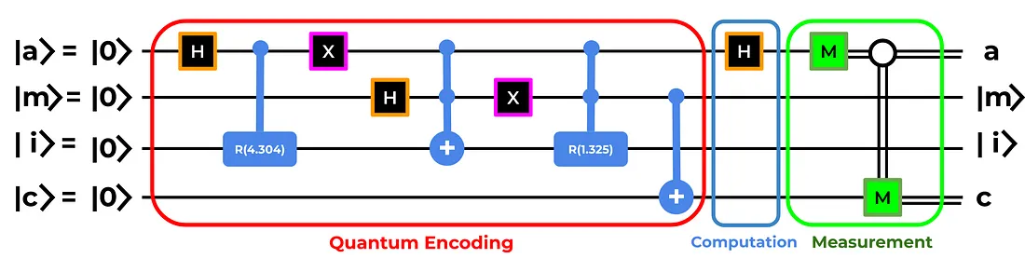
Data Encoding in Quantum Systems
Amplitude Encoding - Encodes a vector as an amplitude of a quantum state
Angle Encoding - Represents vectors as angles on the bloch sphere
Quantum feature maps
Notes:
Data Encoding Challenge:
Quantum systems require classical data to be encoded as quantum states for QML algorithms to process.
Common Encoding Methods:
Amplitude Encoding:
Encodes a vector of data into the amplitudes of a quantum state.
Example: A vector x=[x0,x1,x2,…,xN−1]x = [x_0, x_1, x_2, \ldots, x_{N-1}]x=[x0​,x1​,x2​,…,xN−1​] is mapped to: ∣x⟩=∑i=0N−1xi∣i⟩|x\rangle = \sum_{i=0}^{N-1} x_i |i\rangle∣x⟩=i=0∑N−1​xi​∣i⟩
Angle Encoding:
Represents data points as angles on the Bloch sphere for each qubit.
Data point xix_ixi​ is mapped as: ∣x⟩=cos⁡(xi)∣0⟩+sin⁡(xi)∣1⟩|x\rangle = \cos(x_i) |0\rangle + \sin(x_i) |1\rangle∣x⟩=cos(xi​)∣0⟩+sin(xi​)∣1⟩
Encoding Example in ML:
Quantum Feature Map: Each feature in a dataset can be mapped onto a qubit state using amplitude or angle encoding, allowing the quantum model to operate on it directly.
In clustering tasks, for example, encoding high-dimensional features into qubit states can enable rapid, complex pattern recognition.

Slide 26
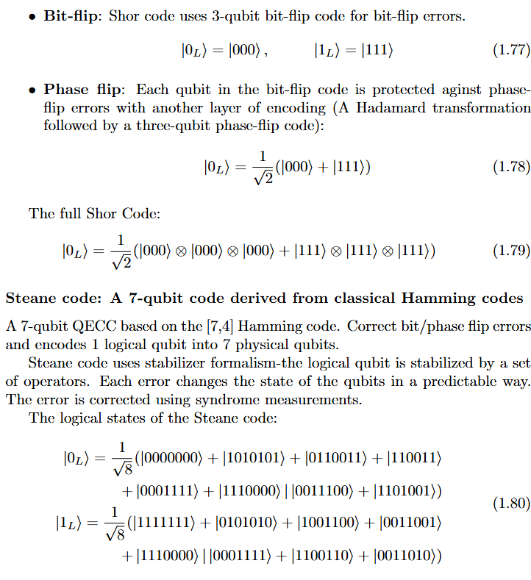
Challenges
Noise
Decoherence
Qubit limitation
Quantum Error Correction
Notes:
Noise and Decoherence:
Noise: Quantum gates are sensitive to external interference, leading to errors in calculations.
Decoherence: Quantum states lose information over time due to interaction with the environment.
Effect: Reduces the accuracy and reliability of quantum computations, limiting circuit depth and runtime.
Scalability:
Qubit Limitations: Current quantum computers have few qubits, restricting the size of data and models they can handle.
Quantum Error Correction: Required to build larger, fault-tolerant quantum systems, but significantly increases hardware requirements.
Implications for AI: Limited qubit numbers and noisy environments make it challenging to apply quantum algorithms at scale for AI tasks involving large datasets.
Current Research Directions:
Hardware Improvements: Developing more stable qubits to reduce noise.
Error Correction Techniques: Quantum error correction codes that increase qubit fidelity.
NISQ Era (Noisy Intermediate-Scale Quantum): Emphasis on algorithms designed for today’s limited-capacity quantum systems, like hybrid approaches with classical preprocessing.

Slide 27
Session 3 Summary
Grover’s, QFT, QAOA, VQE, and QSVM applications in AI
Speedups in search, optimization, signal processing, and classification
Quantum Walks, and QVSM
Notes:
Key Concepts Recap:
Quantum Machine Learning (QML): Application of quantum principles in ML.
VQE: Quantum algorithm for cost function minimization.
QAOA: Quantum algorithm for combinatorial optimization.
Data Encoding: Methods to represent classical data as quantum states.
Next Session Preview:
Quantum Graph Neural Networks (QGNNs): Focusing on applying quantum computing to graph-based AI tasks, commonly seen in social networks, biological systems, and recommendation engines.

